Slide 1
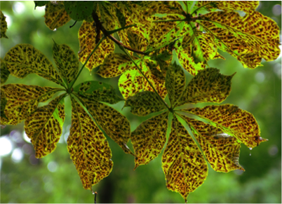
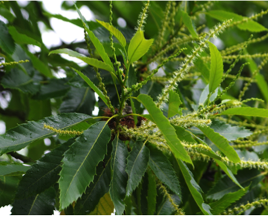
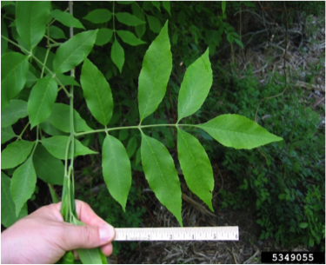
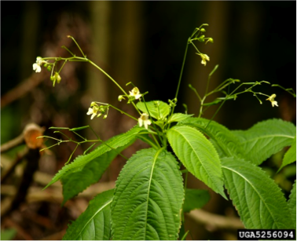
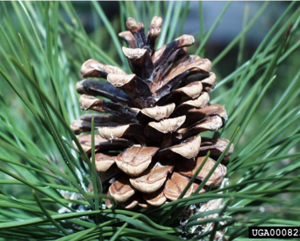
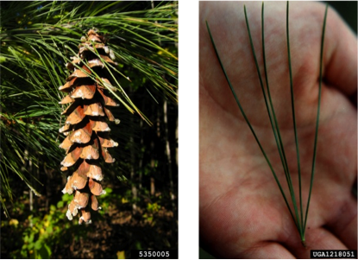
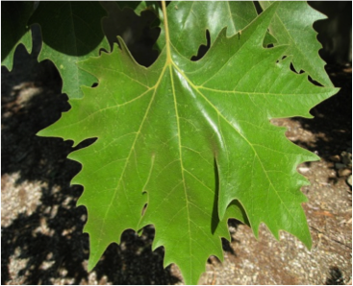
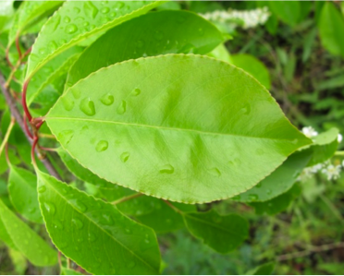
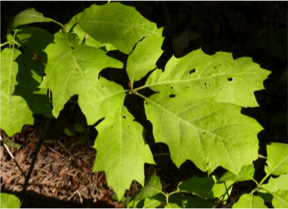
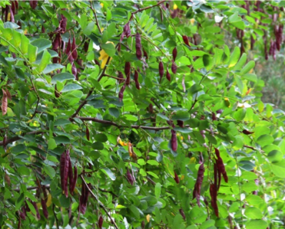
www.korina.info
www.korina.info
© Keith Kanoti Main Forest Service Bugwood.org
© Jan Samanek, State Phytosanitary Administration, Bugwood.org
© Paul Wray Iowa State University Bugwood.org
© Keith Kanoti Maine Forest Service
re Bill Cook Michigan State University Bugwood.org
© Line1
www.korina.info
www.korina.info
www.korina.info

